Slide 1


VIVEKANANDA INSTITUE OF TECHNOLOGY (Affiliated to VTU and approved by AICTE) Gudimavu, Kumbalagodu post, Kengeri, off Mysore road Bengaluru-560074
DEPARTMENT OF CIVIL ENGINEERING
A Presentation
On
“EXPERIMENTAL STUDY ON PARTIAL REPLACEMENT OF FINE AGGREGATE USING WASTE BRICK POWDER”
Presented By:
MAHADEV PRASAD N M ( 1VK18CV008 )
NANDISH U ( 1VK19CV403 )
NITHIN M ( 1VK19CV404 )
VINAY M SAWANT ( 1VK19CV407 )
VIII SEM
Department of Civil Engineering, VKIT
Guided By:
Dr. C S SHASHIKUMAR
Associate Professor & Head of
Dept. of Civil Engineering
VKIT, Bengaluru

Slide 2
CONTENTS
INTRODUCTION
LITERATURE
MATERIALS & METHODOLOGY
TESTS
RESULTS & CONCULUSION
REFERENCES

Slide 3
INTRODUCTION
Civil engineering is a professional engineering discipline that deals with the design, construction, and maintenance of the physical and naturally built environment, including public works such as roads, bridges, canals, dams, airports, sewerage systems, pipelines, structural components of buildings, and railways.
About 3 billion tones demolition waste is generated annually over the globe and 14.5 million tones in India.
Nowadays, this waste constitutes serious socio-economic and environmental problems. Through its transportation and treatment process, construction and demolition wastes (CDW) are harmful to the environment due to the greenhouse gas emissions and demolition waste disposal are difficult to manage.
Waste brick can be recycled and reused as aggregates.

Slide 4
WASTE BRICK POWDER
Bricks are widely used construction and building material around the world. Bricks have been major construction and building material for a long time.
Brick powder is obtained from the dust of disintegrated bricks also the waste bricks are obtained from garbage of a broken building. The collected waste bricks are pulverized to get the particle passing through 4.75-micron sieve to get the grading of fine aggregate for 15%, 25%,30%,40% and 50% of brick powder is used as partial replacement for fine aggregate in the experiments.
Bricks waste may come from two sources: The first source is the bricks industry, and this waste is classified as non-hazardous industrial waste, the second source of bricks waste is associated with construction and demolition activity.
Therefore the replacement of fine aggregate by bricks wastes has the advantage of solving several environmental problems.

Slide 5
OBJECTIVES
The main objectives of present study are:
To study the suitability of waste brick powder in concrete.
To study the desirable properties of waste brick powder in concrete.
To evaluate the utility of crushed brick as a partial replacement of sand in concrete.
To understand the effectiveness of brick as in strength enhancement.
SCOPE OF THE STUDY:
To use waste brick powder as a construction material.
It will slightly reduce the dependency on natural sand or M sand.
Its use will also help in protecting the environment surroundings.

Slide 6
LITERATURE REVIEW
Farid Debieb (2007): Recycling and reuse of building rubble present interesting possibilities for economy on waste disposal sites and conservation of natural resources. This paper examines the possibility of using crushed brick as coarse and fine aggregate for a new concrete. Either natural sand, coarse aggregates or both were partially replaced (25, 50, 75 and 100%) with crushed brick aggregates. Compressive and flexural strengths up to 90 days of age were compared with those of concrete made with natural aggregates. Porosity, water absorption, water permeability and shrinkage were also measured.
J. Martina Jenifer, Et al., (2016): This study aimed to investigate the suitability of using crushed brick in concrete. Crushed brick originated from demolished masonry was crushed in the laboratory and added partial sand replacement. Three replacement levels, 15%,20% and 25%, were compared with the control. The tests on concrete showed that the mechanical properties (compressive, flexural and splitting tensile strengths) of concrete containing crushed brick were well comparable to those of the concrete without ground brick.

Slide 7
Diniya David, Et al., (2017): In this present experimental investigation, the cellular property is achieved by addition of aluminum metal powder in varied percentages such as 0.5, 1, 1.5, 2, 2.5, and 3%. Crushed clay brick is used as replacement of conventional fine aggregate with varied percentages such as 10, 20,23,25,27 and 30% in each percentage of cellular concrete. The cellular property is improved by increased addition of aluminum metal powder. The compressive strength will increase up to 25% replacement of crushed clay brick in cellular concrete.
Shruthi H G, Et al., (2017): This study aimed to investigate the suitability of using crushed brick in concrete. Crushed brick originated from demolished masonry was crushed in the laboratory and added partial sand replacement. Five replacement levels, 10%,20% ,30%,40%, 50%, were compared with the control. The tests on concrete showed that the mechanical properties (compressive strengths) of concrete containing crushed brick were well comparable to those of the concrete without ground brick.

Slide 8
R. Veerakumar, (2018): This study aimed to investigate the suitability of using brick debris in concrete in place of fine aggregate. Brick debris originated from demolished masonry walls crushed in the laboratory and added in partial fine aggregate replacement. Four replacement levels, 5%, 10%, 15%, and 20%, were compared with the control. The tests on concrete showed that the mechanical properties (compressive strength test) of concrete containing brick debris were well comparable to those of the concrete without ground brick.
Awadhesh Chandramauli, et.al., (2018): The waste material of fire bricks can be used as fine aggregates. Properties of fire bricks are increases the strength of concrete. This research able to reduce the dependency on sand and open a new option to dispose of waste fire bricks. Partial replacement is done at 0%, 22%, 25%, 28% and 31% in this project. The test result says the 28% replacement gives the maximum tensile strength.
Anayat Ali, et.al., (2019): This research review will discuss the partial replacement of fine aggregate with brick dust and how to reduce the dependency on the natural resources such as sand used as fine aggregate and provide a new way to dispose of waste brick debris. Different replacement levels 10%, 15%, and 20%, will be checked. Different tests showed that the compressive strength is enhanced by using optimum percentage replacement of natural fine aggregate with brick debris compared to conventional mortar and concrete.

Slide 9
CONCLUSION OF LITERATURE REVIEW:
A comprehensive review of literature covering papers from Journals and conferences was carried out: papers reviewed were predominantly based on Waste brick powder. The literature review indicates that very few publications are available on the waste brick powder, Variables aspect ratio such as, different grades of concretes and different percentages of brick powder are simultaneously covered in papers reviewed. Therefore, there is requirement for the study the both compressive strength and Flexural strength of concrete preparing using waste brick powder as a partial replacement of fine aggregate.

Slide 10
MATERIALS & METHODOLOGY
Cement : Ordinary Portland cement of grade 53.
Fine aggregate : Fine aggregate passing 4.75mm IS sieve.
Coarse aggregate : Segregated aggregates retaining 4.75mm IS sieve and passing 20mm IS sieve.
Waste brick powder : passing 4.75mm IS sieve.
Water : Required amount of water by trial.

Slide 11
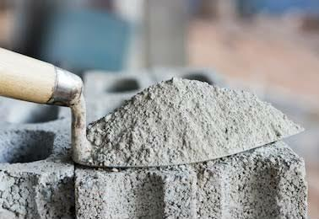
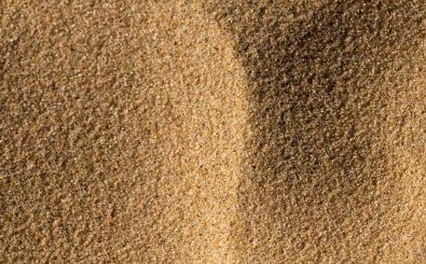
TESTS ON MATERIALS.
CEMENT
Normal consistency.
Specific gravity.
FINE AGGREGATE
Fineness modulus and zoning.
Specific gravity.
Bulk density of fine aggregate.

Slide 12
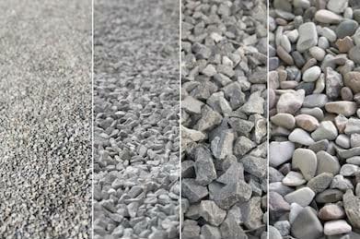
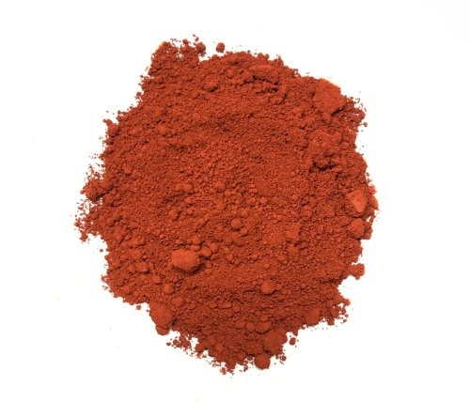
COARSE AGGREGATE
Fineness modulus and grading.
Specific gravity.
BRICK POWDER
Fineness modulus and zoning.
Specific gravity.

Slide 13
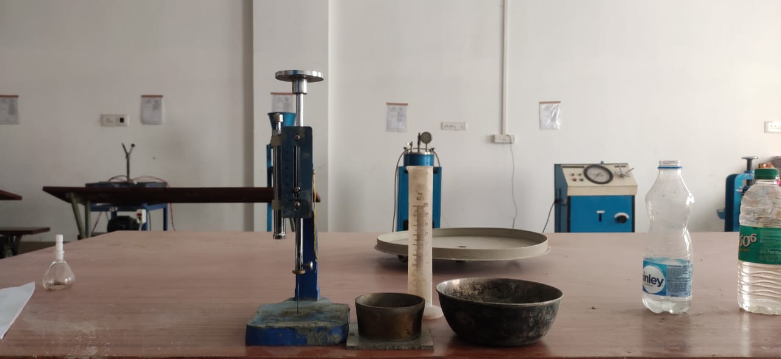
TESTS ON CEMENT
Normal consistency of cement:
Weight of cement = 300gm.
Trial | Water (%) | Water (ml) | Initial reading (mm) | Final reading (mm) | Percentage of Plunger
01 | 27 | 100 | 41 | 38 | 3
02 | 29 | 104 | 41 | 36 | 5
03 | 30 | 112 | 41 | 16 | 25
04 | 31 | 116 | 41 | 12 | 29
05 | 32 | 120 | 41 | 06 | 35
Percentage of water required for STD consistency= 32%

Slide 14
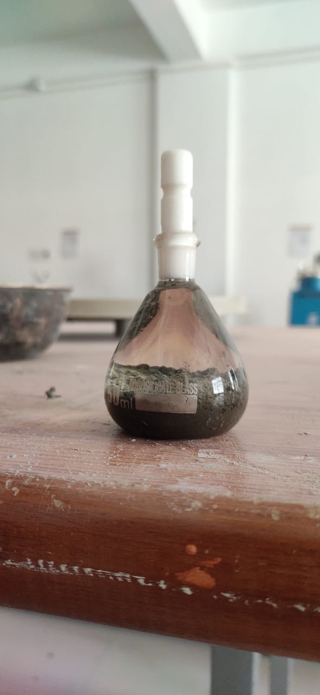
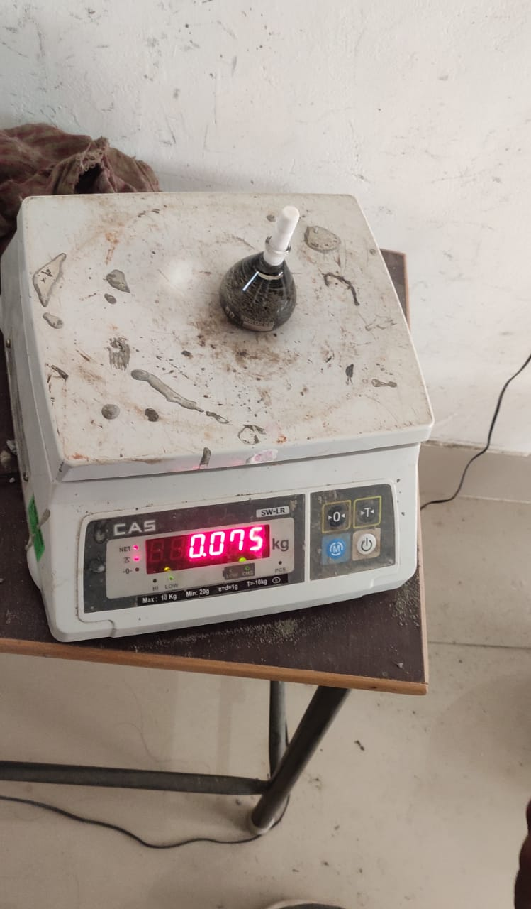
Specific gravity of cement.
Density bottle method:
Wt. of cement taken W = 19 gm.
Specific gravity = W2-W1/(W2-W1)-(W3-W4)
Specific gravity of cement = 3.15
(All weights are in grams)
Sl no | Empty weight of density bottle (W1) | Weight of bottle + cement (W2) | Weight of bottle + cement+ kerosene (W3) | Weight of bottle + kerosene (W4)
01 | 25 | 44 | 75 | 62

Slide 15
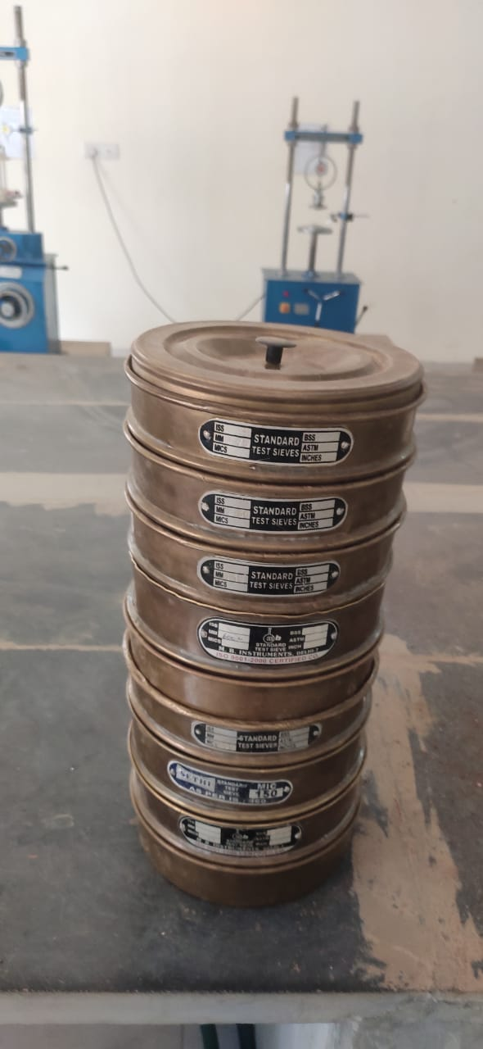
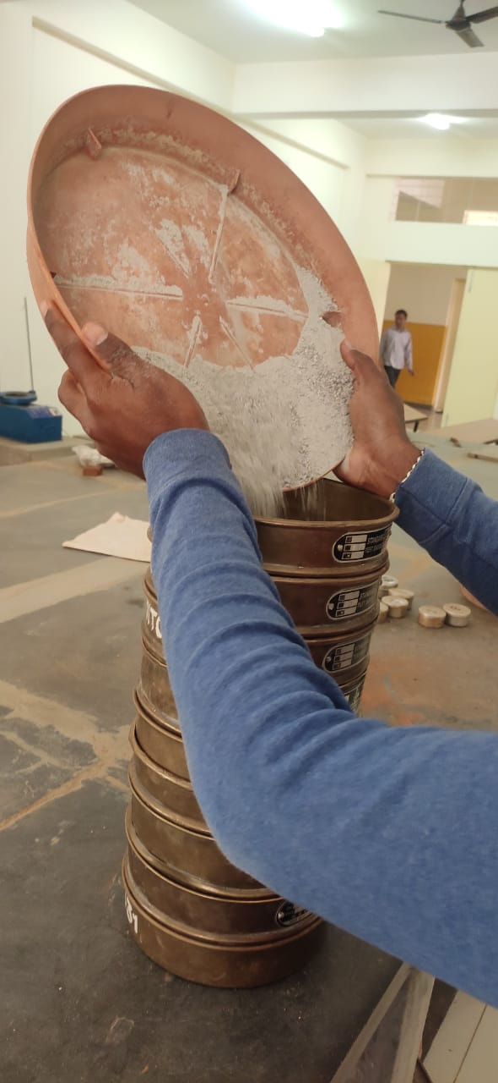
TESTS ON FINE AGGREGATE
Fineness modulus of fine aggregate.
Weight of aggregate = 1 kg
Sl no | IS Sieve(mm,µ) | Weight Retained(g m) | Cumulative Weight Retained(gm) | Cumulative Retained(%) | Cumulative Passing(%)
1 | 4.75 | 0 | 0 | 0 | 100
2 | 2.36 | 75 | 7.5 | 7.5 | 92.5
3 | 1.18 | 227 | 22.7 | 30.2 | 69.8
4 | 600 | 172 | 17.2 | 47.4 | 52.6
5 | 425 | 154 | 15.4 | 62.8 | 37.2
6 | 300 | 30 | 3 | 65.8 | 34.2
7 | 150 | 215 | 21.5 | 87.3 | 12.7
8 | 75 | 102 | 10.2 | 97.5 | 2.5
9 | Pan | 25 | 2.5 | 100 | 0
Fineness modulus ∑ = (cum retained%) / 100
Fineness modules of fine aggregate = 2.75
RANGE 2.2 – 3.2

Slide 16
Fineness modules of fine aggregate = 2.75
AS PER INDIAN CODES THE GRADATION OF FINE AGGREGATE SHOULD BE BETWEEN 2.2 – 3.2

Slide 17
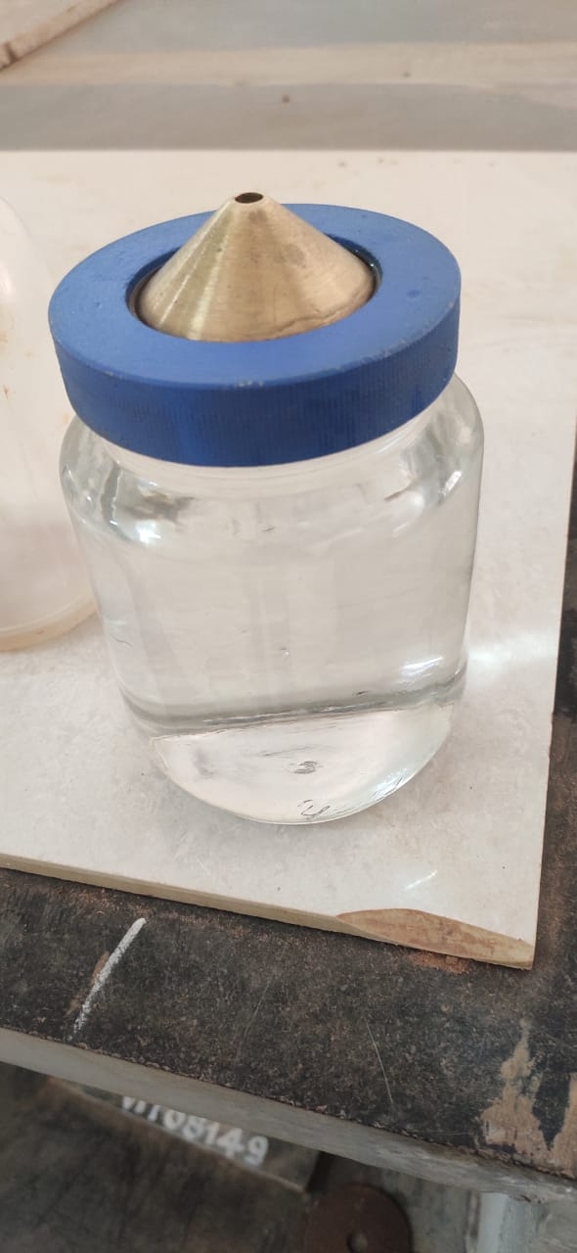
Specific gravity test on fine aggregate.
Specific gravity of fine aggregate= W2-W1
Sl no | Weight (gm) | Trial 1 | Trial 2 | Trial 3
1 | Weight of empty Pycnometer(W1) | 661 | 661 | 661
2 | Weight of empty Pycnometer + FA (W2) | 1066 | 1075 | 1062
3 | Weight of empty Pycnometer + FA + water (W3) | 1785 | 1797 | 1790
4 | Weight of empty Pycnometer + water (W4) | 1540 | 1540 | 1540
5 | Specific gravity | 2.53 | 2.63 | 2.65
= 2.60
(W2-W1) – (W3-W4)

Slide 18
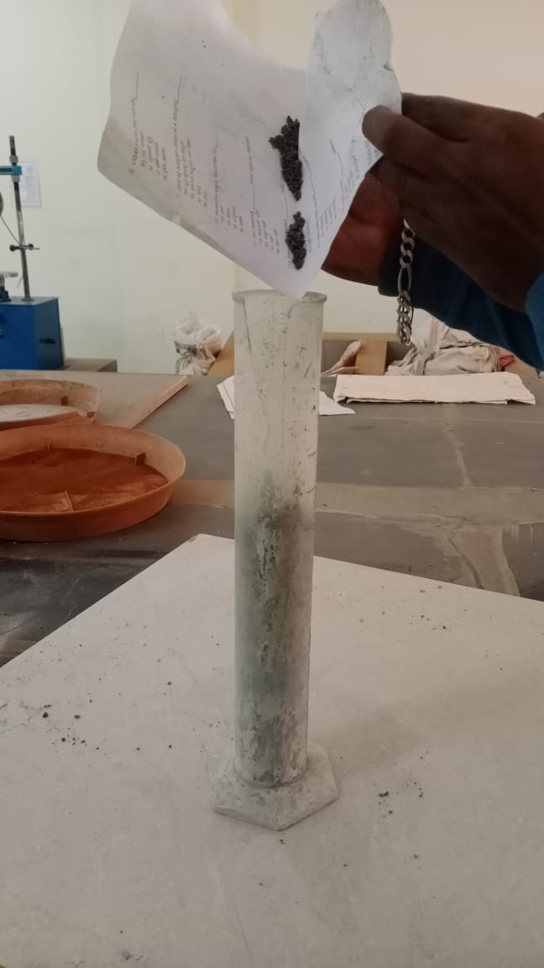
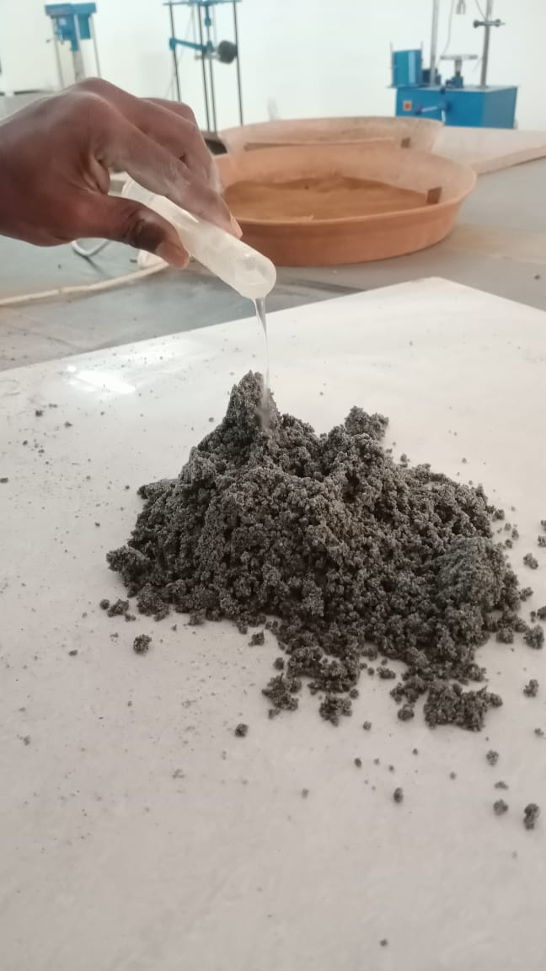
Bulking of fine aggregate.
Weight of fine aggregate= 500gm.
Initial height of sand H1= 300mm.
Maximum bulking of fine aggregate= 46%
Sl no | % of water | Volume of water in ml | Height of sand | Page bulking H2-H1
*100
H1
1 | 2 | 10 | 375 | 25
2 | 2 | 10 | 390 | 30
3 | 2 | 10 | 410 | 36
4 | 2 | 10 | 440 | 46
5 | 2 | 10 | 390 | 30
6 | 2 | 10 | 345 | 15

Slide 19
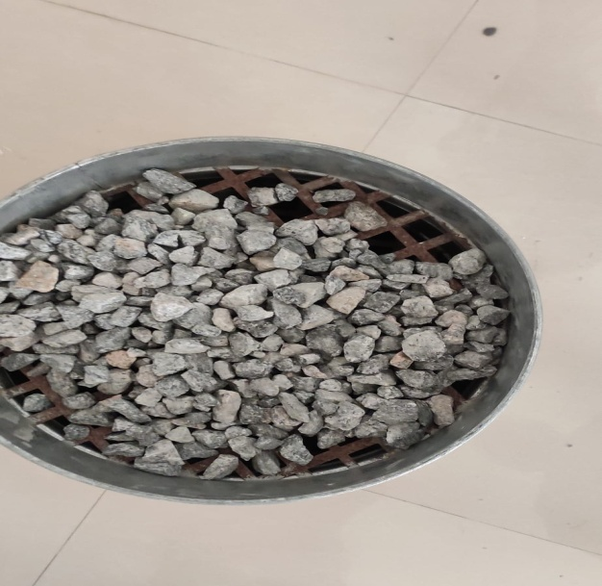
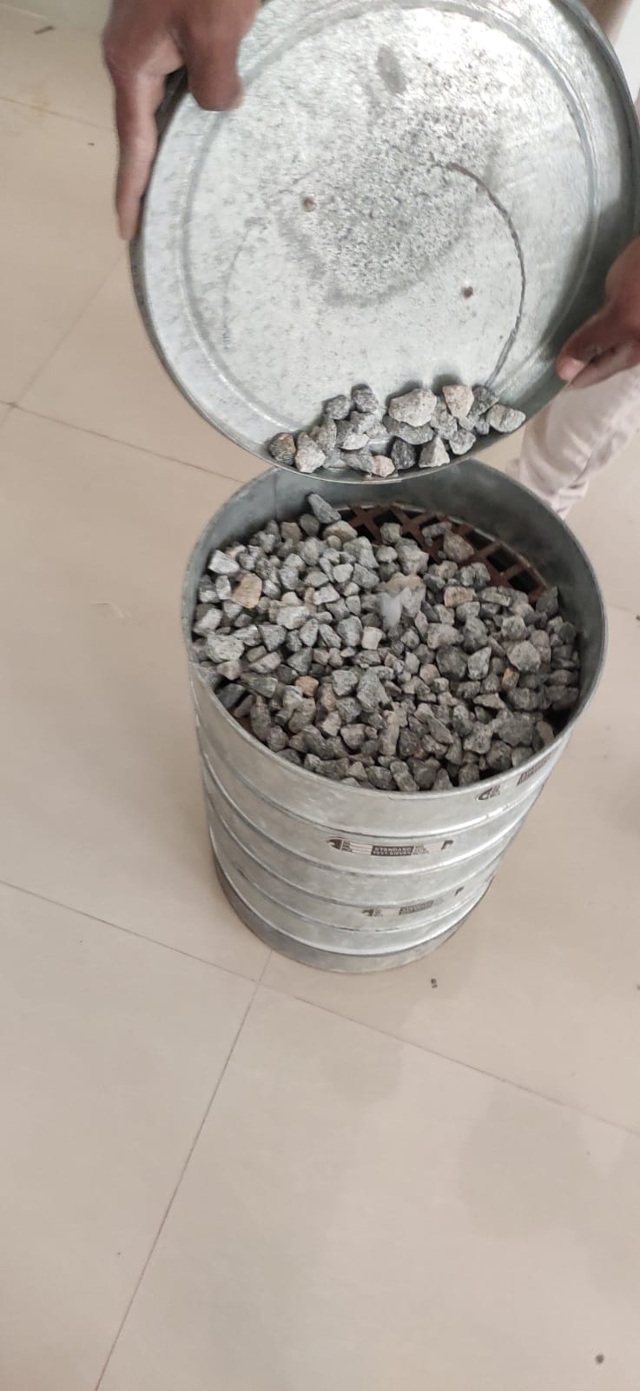
TESTS ON COARSE AGGREGATE
Fineness modulus of coarse aggregate.
Weight of aggregate = 3 kg.
Sl no | IS Sieve(mm,µ) | Weight Retained(gm) | Cumulative Weight Retained(gm) | Cumulative Retained(%) | Cumulative Passing(%)
1 | 80 | 0 | 0 | 0 | 100
2 | 40 | 0 | 0 | 0 | 100
3 | 20 | 91 | 3.03 | 3 | 97
4 | 16 | 1000 | 33.33 | 36 | 64
5 | 12.5 | 1286 | 42.86 | 78.86 | 21.14
6 | 10 | 441 | 14.7 | 93.56 | 6.44
7 | 6.3 | 102 | 3.4 | 96.96 | 3.04
8 | 4.75 | 60 | 2 | 98.96 | 1.04
 | Pan | 20 | 0.6 | 99.56 | 0.44
Fineness modulus of coarse aggregate= 7.1
RANGE 5.5 – 8

Slide 20
FROM ABOVE IT IS CONCLUDED THAT THE COARSE AGGREGATE BELONGS TO ZONE – 2

Slide 21
Specific gravity test on coarse aggregate.
Weight of aggregate taken = 2 KG
SL NO | DETAILS OF SAMPLE | OBSERVATION
1 | Weight of saturated dry aggregate (w1) | 2000
2 | Weight of aggregate suspended in water with basket (w2) | 1324
3 | Weight of basket suspended in water (w3) | 7
4 | Weight of saturated aggregate in water (w2 – w3)= w_{s} | 1324-7=1317
5 | Weight oven dry aggregate =(w4)/(w1 - ws) | 1995
6 | Specific gravity= (w4)/(w1-w_{s}) | 2.88

Slide 22
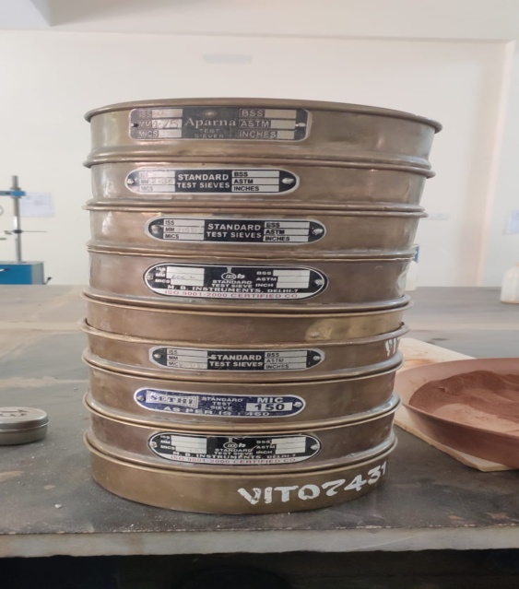
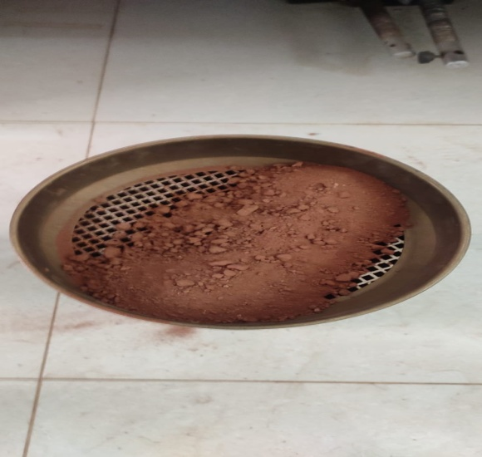
TESTS ON BRICK POWDER
Fineness modulus of brick powder.
Weight of brick powder = 1 kg
Sl no | IS Sieve(mm,µ) | Weight Retained(g m) | Cumulative Weight Retained(gm) | Cumulative Retained(%) | Cumulative Passing(%)
1 | 4.75 | 28 | 2.8 | 2.8 | 97.2
2 | 2.36 | 94 | 9.4 | 12.2 | 87.8
3 | 1.17 | 117 | 11.7 | 23.9 | 76.1
4 | 600 | 127 | 12.7 | 36.6 | 63.4
5 | 425 | 156 | 15.6 | 52.2 | 47.8
6 | 300 | 33 | 3.3 | 55.2 | 44.5
7 | 150 | 237 | 23.7 | 72.2 | 20.8
8 | 75 | 149 | 14.9 | 94.1 | 5.9
 | Pan | 59 | 5.9 | 100 | 0
Fineness modulus ∑ = (cum retained%) / 100 = 2.4

Slide 24
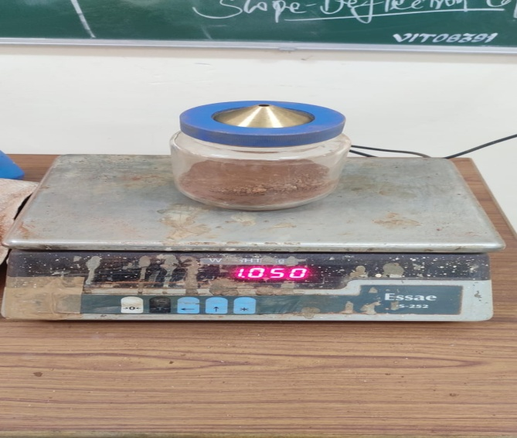
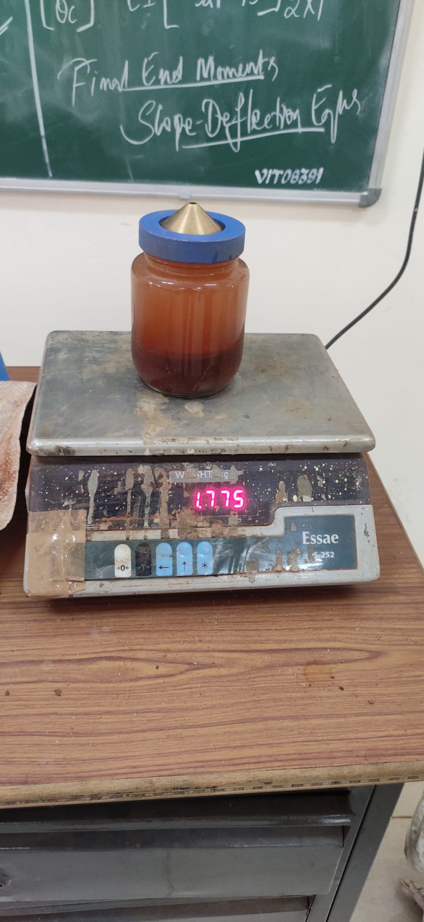
Specific gravity test on brick powder.
Specific gravity of fine aggregate =
Weight of brick powder taken = 390 gm
Sl no | Weight (gm) | Trial 1 | Trial 2 | Trial 3
1 | Weight of empty Pycnometer(W1) | 659 | 659 | 659
2 | Weight of empty Pycnometer + BP (W2) | 1050 | 1055 | 1041
3 | Weight of empty Pycnometer + BP + water (W3) | 1775 | 1781 | 1780
4 | Weight of empty Pycnometer + water (W4) | 1541 | 1541 | 1541
5 | Specific gravity | 2.64 | 2.53 | 2.67
W2-W1
= 2.61
(W2-W1) – (W3-W4)

Slide 25
MIX PROPORTON OF CONCRETE
The mix proportion is designed for M25 concrete conforming IS codes.
Step-1 STIPULATION FOR PROPORTIONING
Grade= M25
Type of cement= OPC 53 Grade
Max. size of aggregate= 20mm
Min. cement content and max. water cement ratio = Moderate (IS – 456: 2000 Table 5)
Workability= 100mm Slump
Method of Concrete placing = Non- pumpable
Type of aggregate= crushed angular
Fine aggregate= Zone - 2
Step-2 TEST DATA
Specific gravity of cement= 3.16
Specific gravity of coarse aggregate= 2.88
Specific gravity of fine aggregate= 2.60
Water absorption of Coarse aggregate = 0.65%
Water absorption of fine aggregate= 1.01%
Specific gravity of water = 1

Slide 26
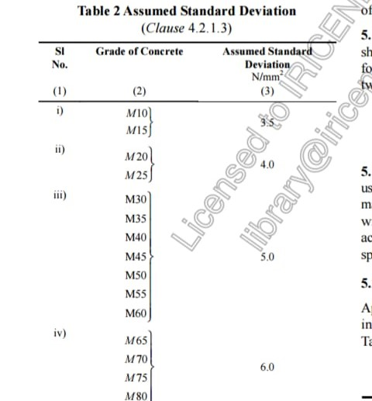
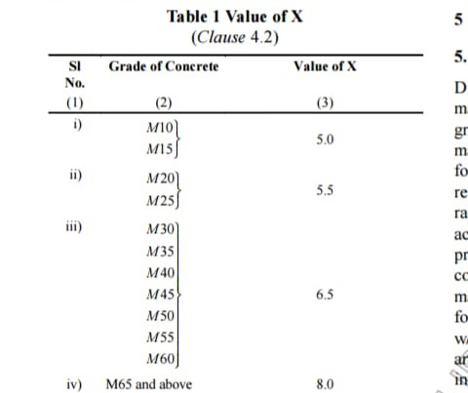
Step-3 TARGET STRENGTH
f’ck = fck+1.65(S) S=4 ( from IS 10262 Table-2)
= 31.6 N/mm²
f’ck= fck+x x= 5.5 ( from IS 10262 Table-1)
= 30.5 N/mm²
Therefore f’ck= 31.6N/mm² ( Considering higher value )
Step-4 WATER CEMENT RATIO
0.5 ( AS PER IS:456 TABLE 5 )
Step-5 SELECTION OF WATER CONTENT
For 20MM aggregate – 186 kg for ( 100 mm slump )
( from IS 10262 Table 5 )
For every 25mm add 3%
186+6% of 186
= 197.16 kg ( Mass of water)

Slide 27
Step- 6 CALCULATION OF CEMENT CONTENT :
W/C RATIO = W/C
C = W/(W/C)
= 197/0.5
= 394 kg/m3 > 300 kg /m³
Step-7 PROPORTION BETWEEN COARSE AGGREGATE AND FINE AGGREGATE :
IS - 10262 Table – 5 ( 1.5.5.1 )
Zone 2 = 0.62 ( For w/c = 0.5 )
Volume of coarse aggregate = 0.62m³
Volume of fine aggregate = 1 -0.62 = 0.38m³
Step – 8 MIX CACULATIONS :
Total Volume= 1m3
Volume of entrapped air = 0.01m³
Volume of cement = mass of cement/sp. Gravity (1/1000)
= 394/3.10=0.124m³

Slide 28
Volume of water = Mass of water /specific gravity of water
= 197/1000
=0.197m³
Volume of all aggregate = (1-0.01)-(0.124+0.197)
= 0.669m³
Mass of Coarse aggregate = E* volume of CA* sp. Gravity of CA*1000
= 0.669*0.62*2.88*1000
=1194.54kg
Mass of Fine aggregate = E* volume of FA* sp. Gr. Of FA*1000
= 0.669*0.38*2.60*1000
= 660.97kg
Step-9 MIX PROPORTION
Cement = 394 Kg/m³ Water Cement Ratio = 0.5
Water = 197.16Kg/m³
Fine Aggregate = 660.92Kg
Coarse Aggregate = 1194.54 Kg

Slide 29
The Extra Water to Be Added for Absorption by Coarse Aggregate and Fine Aggregate
For Fine Aggregate: -
Mass of FA = Mass of fine aggregate/ (1+ water ratio/100)
= 660.97 / (1+1.01/100)
= 654.36 kg/m³
For Coarse aggregate: -
Mass of CA = mass of coarse aggregate/ (1+water ratio/100)
= 1186.82 kg/m³
1. Fine Aggregate
= 660.97 -654.36 = 6.61 Kg
2. Coarse aggregate
= 1194.54 – 1186.82 = 7.72 Kg
Water to be added = 197.16+6.61+7.72 = 211.49kg

Slide 30
Mix Proportion After Adjustment
Cement= 394kg/m3
Water (to be added) = 211.49 kg/m³
Fine aggregate (dry) = 654.36kg/m³
Coarse aggregate(dry) = 1186.82 kg/m³
Water cement ratio = 0.5
In 0.5 w/c we didn’t get 100mm slump. Now increase the 10% of w/c
TRAIL 2
Increase the 10% of water
water cement ratio =0.6
STEP- 1 CALCULATION OF CEMENT CONTENT
W/C RATIO = W/C
C = W/(W/C)
= 197/0.6
= 328.6 kg/m3 > 300 kg /m³

Slide 31
STEP-2 PROPORTION BETWEEN CA AND FA
IS- 10262 Table – 5 (1.5.5.1)
Zone 2 = 0.62
Volume of coarse aggregate = 0.62
Volume of fine aggregate = 1 -0.62 = 0.38m³
STEP-3 Mix calculation
Total volume=1m³
Volume of entrapped air =0.01m³
Volume of cement = mass of cement/sp. Gravity (1/1000)
= 328.6/3.10=0.103m³
Volume of water = mass of water/sp. Gravity water
= 197/1000=0.197m³
Volume of all aggregate = (1-0.01) - (0.103+0.197)
= 0.69m³

Slide 32
Mass of CA = E*vol. of CA*Sp. of CA*1000
= 0.69*0.62*2.88*1000
=1232.06.54kg
Mass of FA = E*vol. of FA*Sp. of FA*1000
= 0.69*0.38*2.60*1000
=681.72kg
Step-4 mix proportion
Cement = 328.6kg/m³
Water = 197.16kg/m³
Fine aggregate = 681.72kg/m³
Coarse aggregate = 1232.06kg/m
W/C ratio = 0.60

Slide 33
The Extra Water to Be Added for Absorption by Coarse Aggregate and Fine Aggregate
For Fine Aggregate: -
Mass of FA = Mass of fine aggregate/ (1+ water ratio/100)
= 681.72 / (1+1.01/100)
= 674.90 kg/m³
For Coarse aggregate: -
Mass of CA = mass of coarse aggregate/ (1+water ratio/100)
= 1224.05 kg/m³
1. Fine Aggregate
=681.72 -674.90 = 6.82 Kg
2. Coarse aggregate
= 1232.06 – 1224.05 = 8.01 Kg
Water to be added = 197.16+6.82+8.01 = 211.99kg

Slide 34
Mix Proportion After Adjustment
Cement= 328kg/m³
Water (to be added) = 211.99 kg/m³
Fine aggregate (dry) = 674.90kg/m³
Coarse aggregate(dry) = 1224.05 kg/m³
Water cement ratio = 0.60

Slide 35
SLUMP TEST
SLUMP TEST
TEST STANDARD REFERENCE:
Test for Workability - Slump Test as per IS: 1199 1959, Methods of Sampling and Analysis of Concrete.
OBSERVATION:
Height of slump cone: - 300 mm
Top Dia. of cone: - D1= 100mm, R1 = 50mm
Bottom Dia. of cone: - D2=200mm, R2 = 100mm
CALCULATION:
Volume = 1/3(R1²+R2²+R1*R2) H*3.14
= 1/3(50²+100²+(50*100)) * 300*3.14
= 5.265 x10^3 cm³
TABULAR COLUMN: -
SL NO | WATER CEMENT RATIO | Water added in ml | H1 in mm | H2 in mm | Slump (H1-H2) in mm
01 | 0.6 | 1116 | 300 | 200 | 100

Slide 36
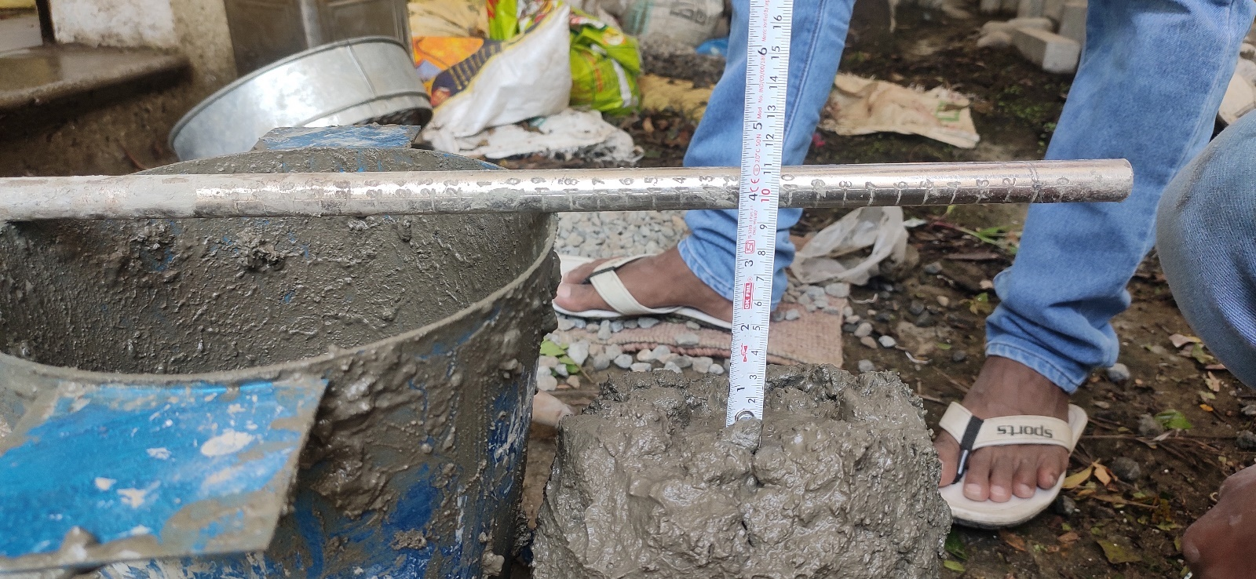
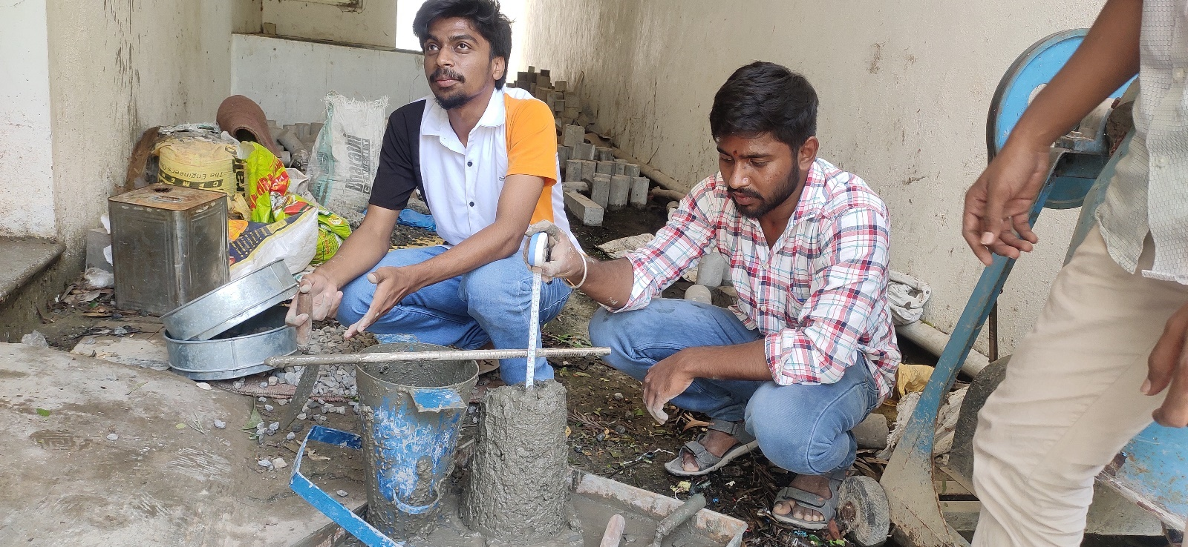
SLUMP CONE TEST
100mm

Slide 37
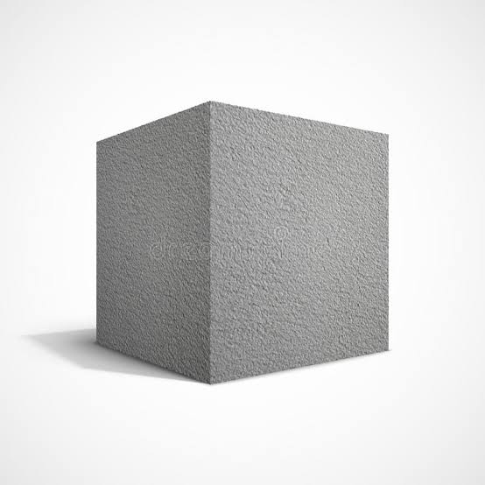
CAST & TEST
The cubes are casted with 0%,15%,25%,30%,40% & 50% as partial replacement of fine aggregate using brick powder.
The cast specimens are tested, after curing the specimens are tested for 7days, 14days and 28 days.
Cube 150x150x150mm

Slide 38
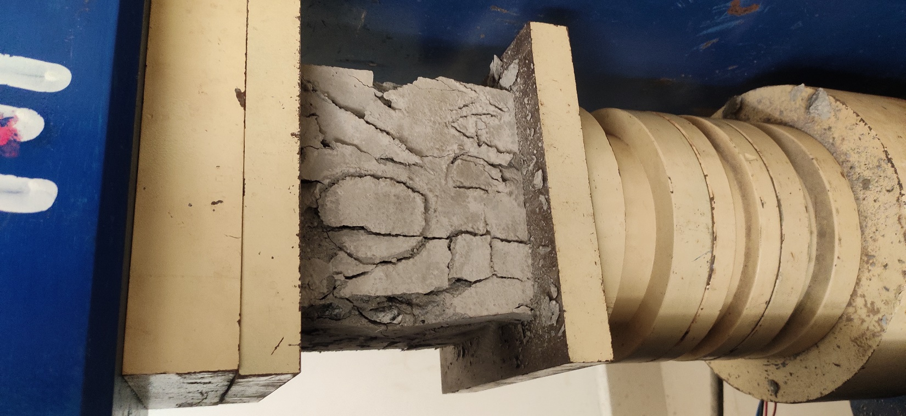
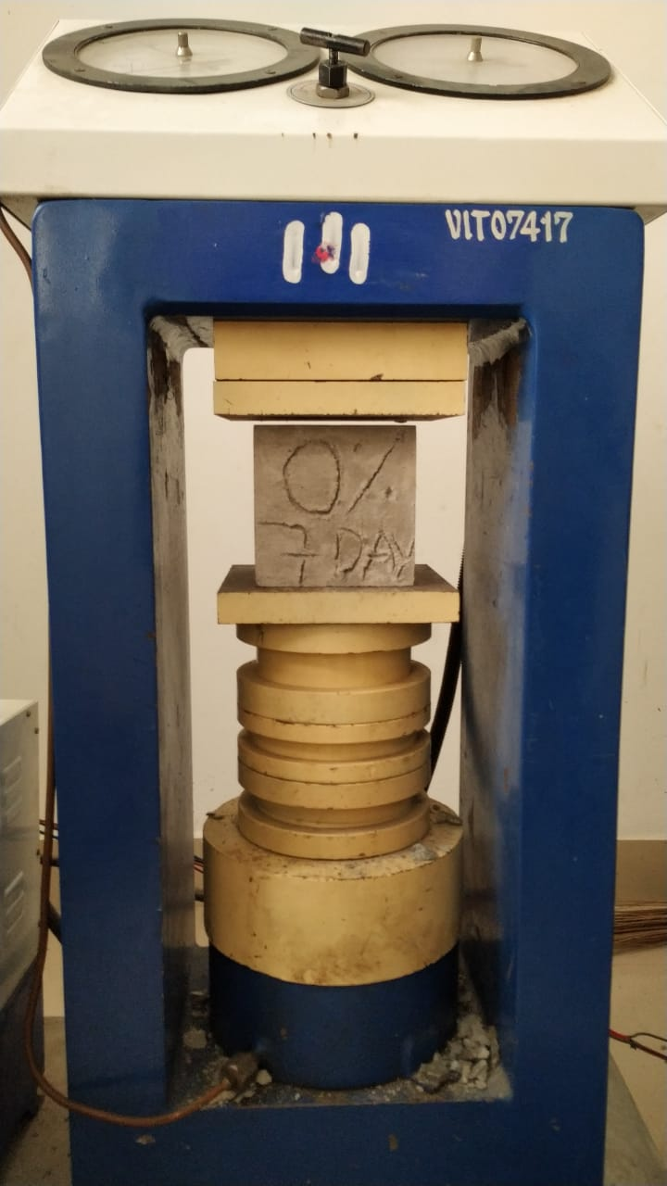
COMPRESSIVE STRENGTH TEST
The compressive strength test is carried on cube size of 150×150×150mm. The cubes will be tested with brick powder of 15%, 25%,30%,40% & 50% and The cubes are cured for 7days, 14days and 28 days.
7 DAYS CURING
Cube without brick powder (0%)

Slide 39
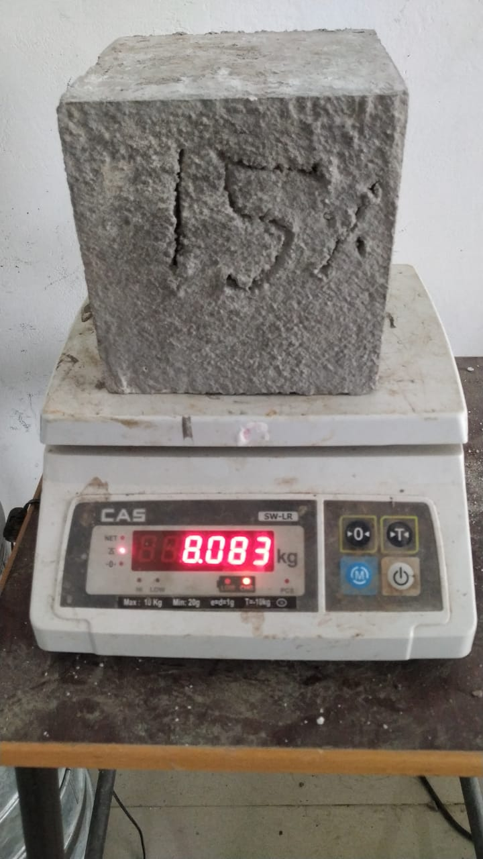
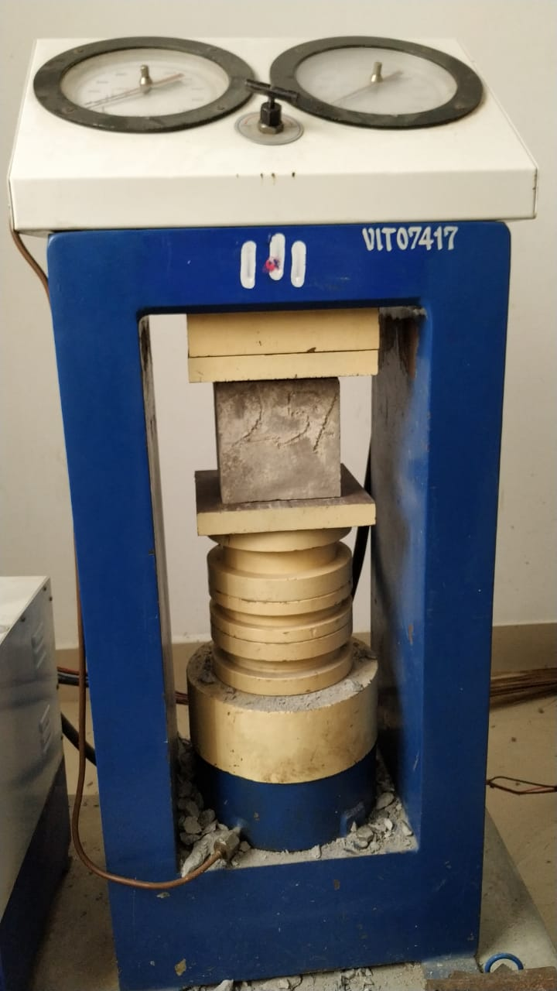
Cube with brick powder (15%) Cube with brick powder (25%):

Slide 40
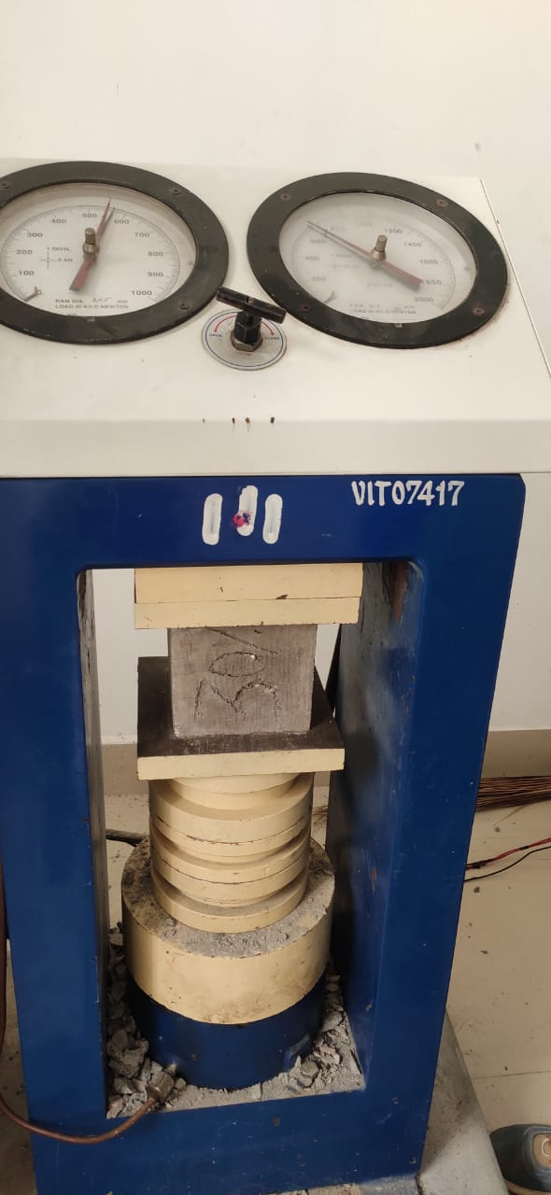
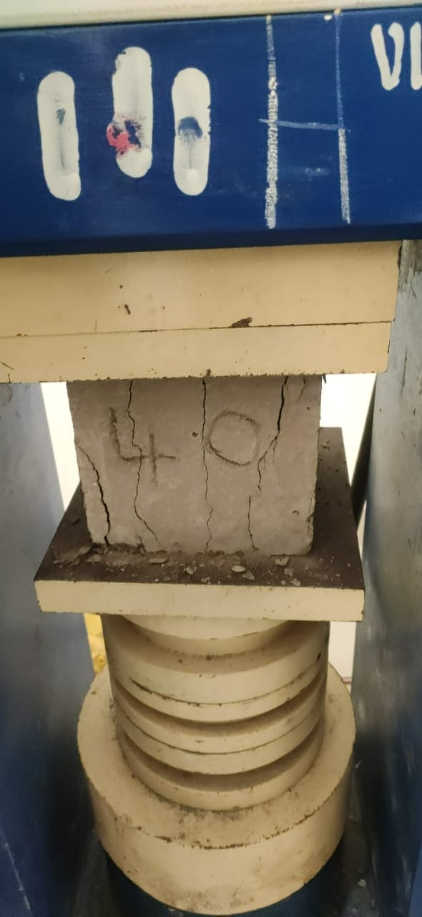
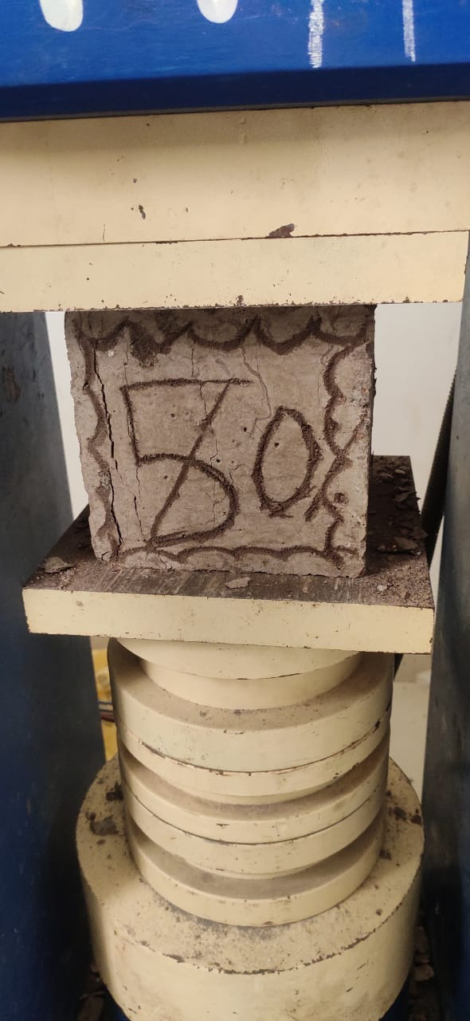
Cube with brick powder (30%) Cube with brick powder (40%) Cube with brick powder (50%)

Slide 41
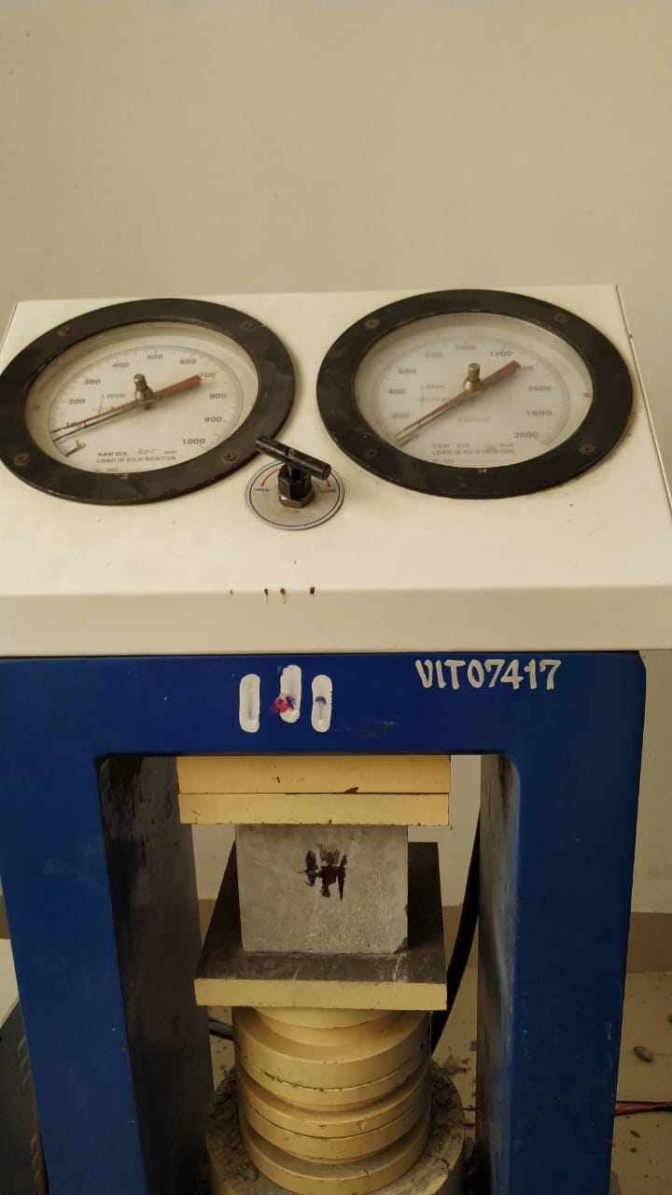
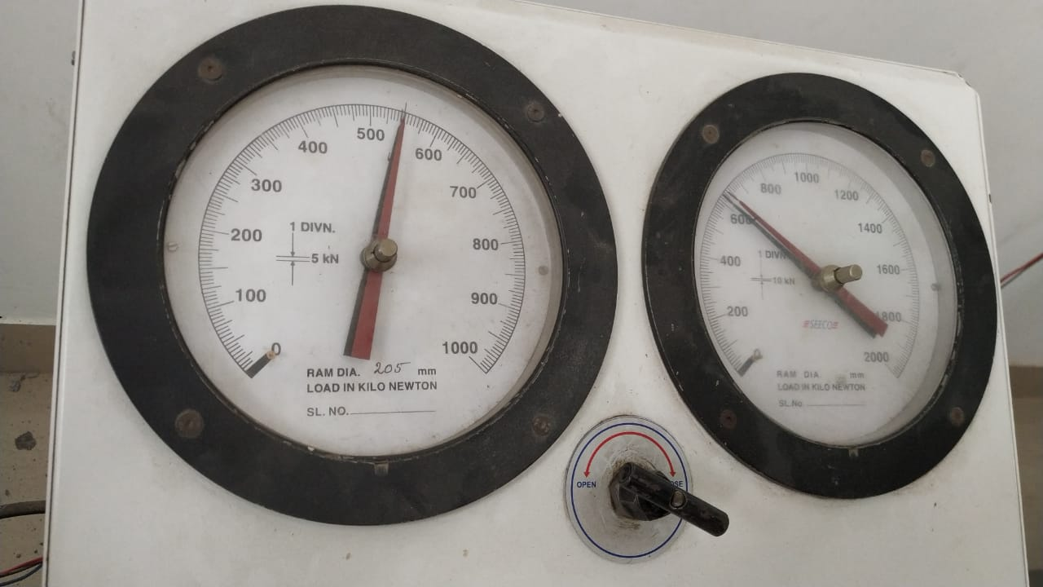
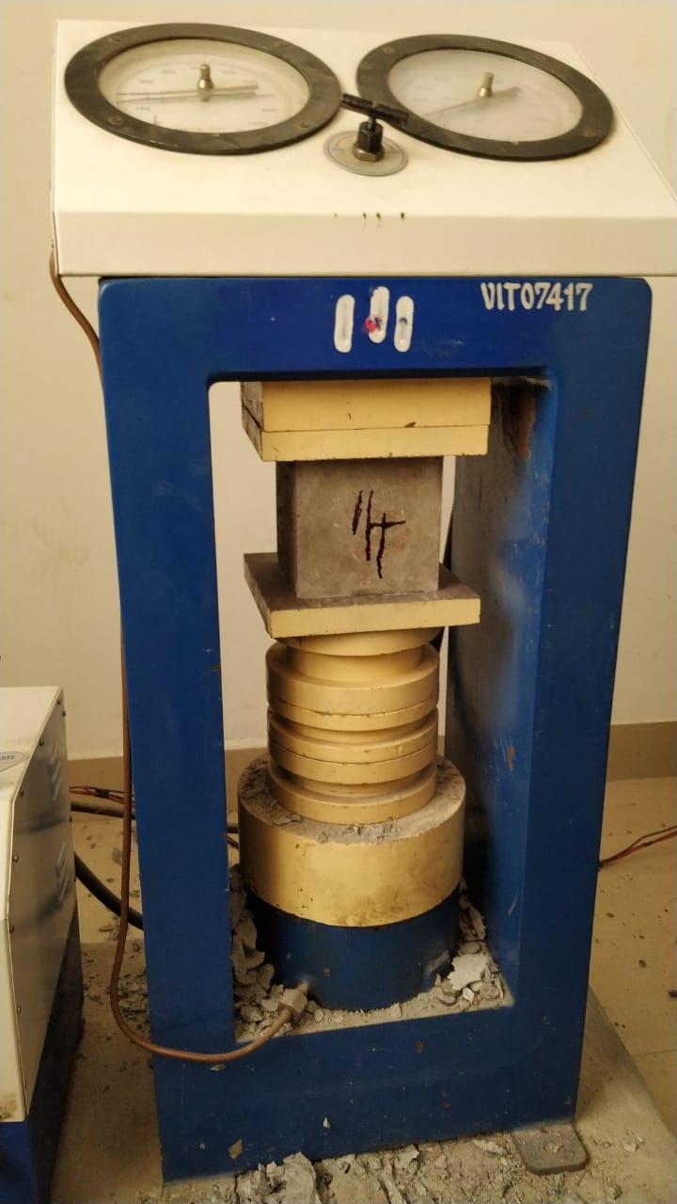
14 DAYS CURING:
Cube without brick powder (0%)
Cube with brick powder (15%)

Slide 42
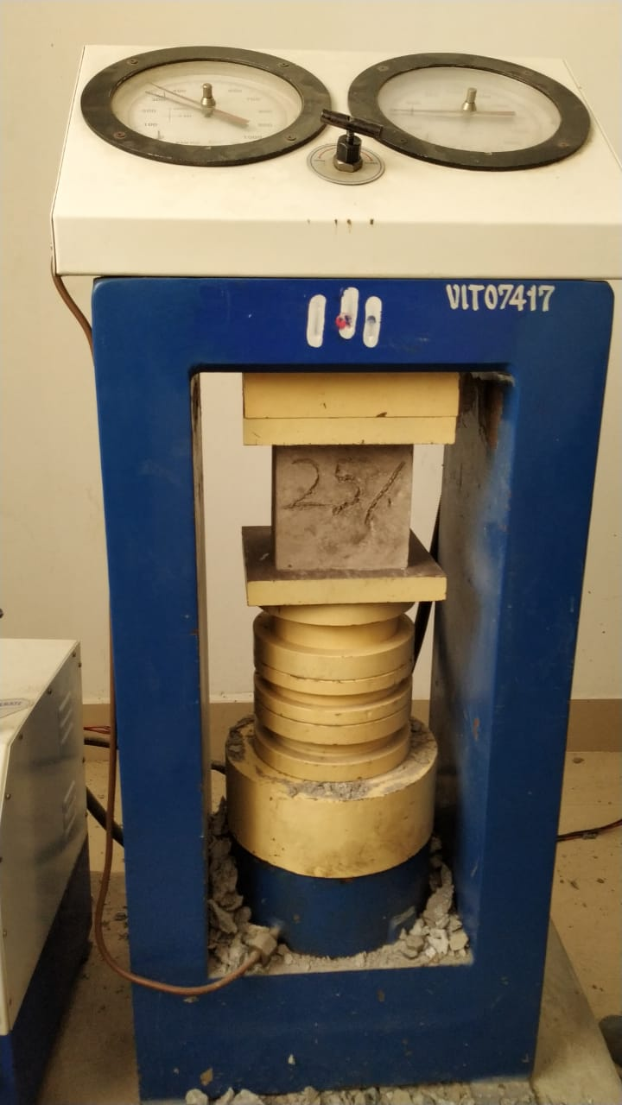
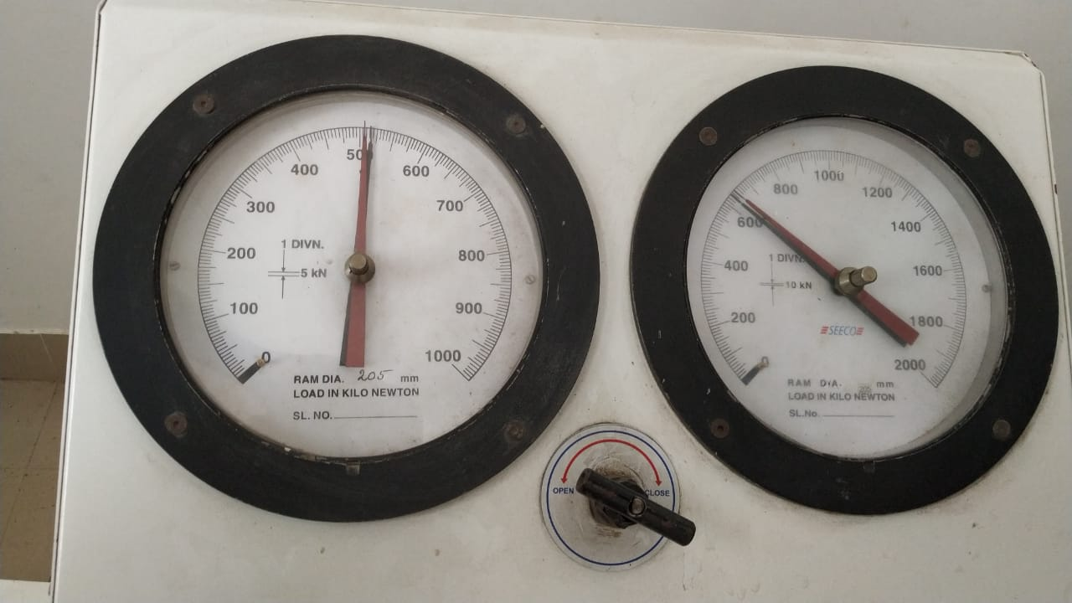
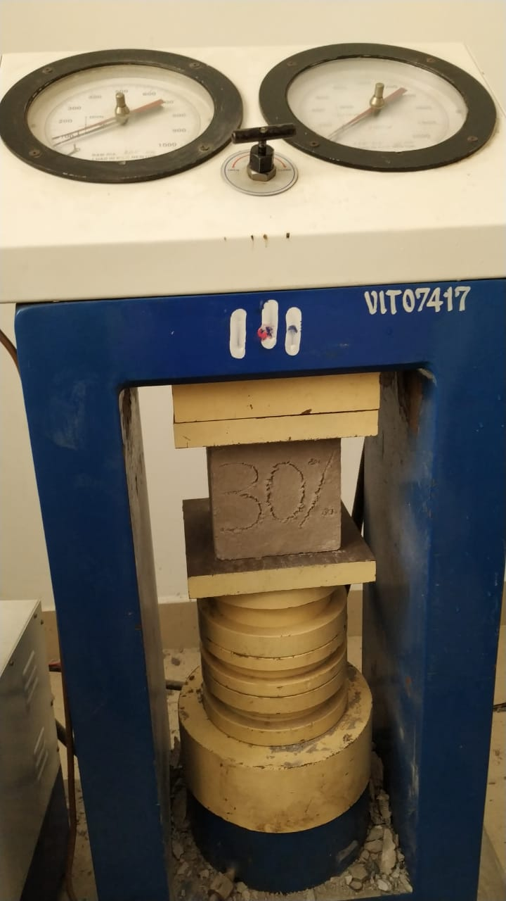
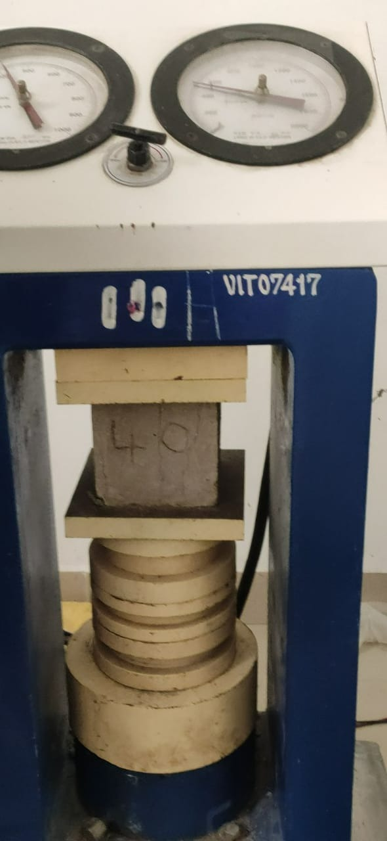
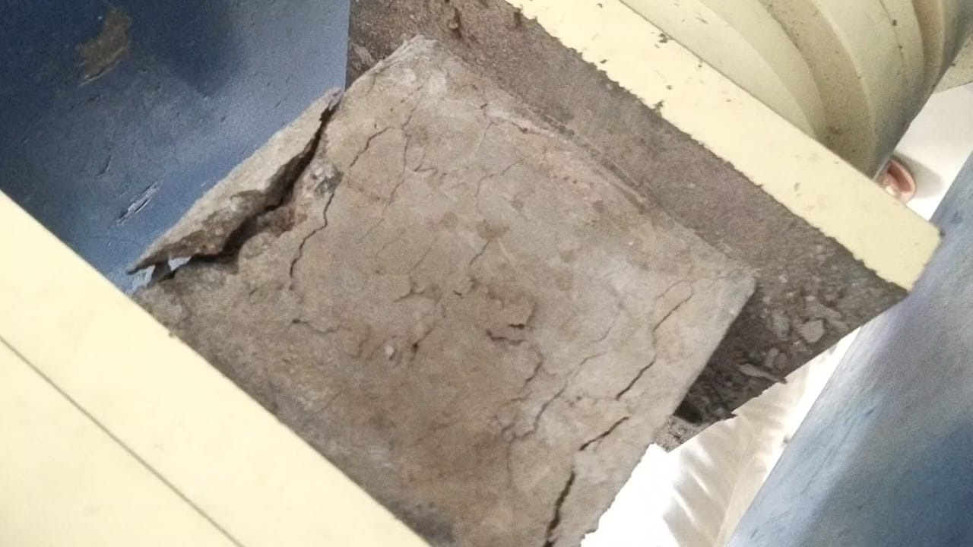
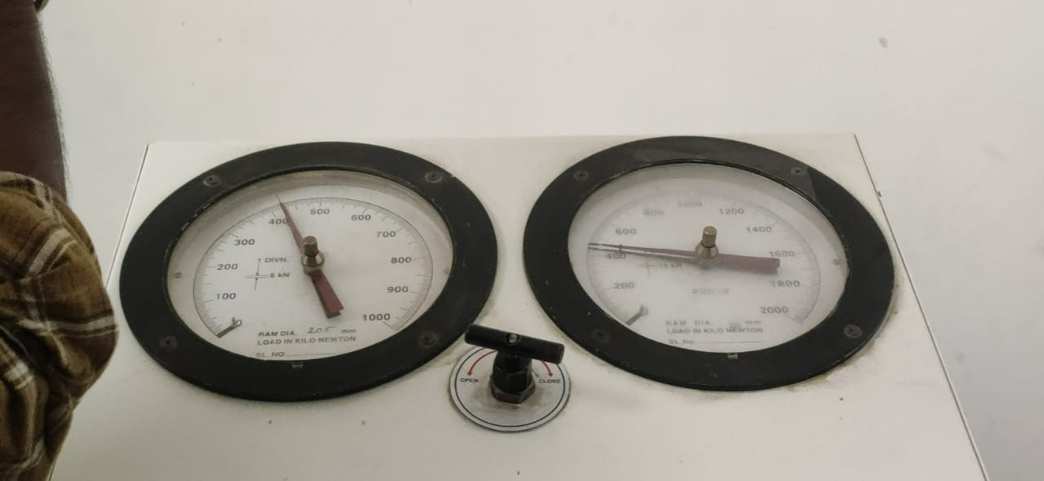
Cube with brick powder (25%) Cube with brick powder (30%):
Cube with brick powder (40%) Cube with brick powder (40%)

Slide 43
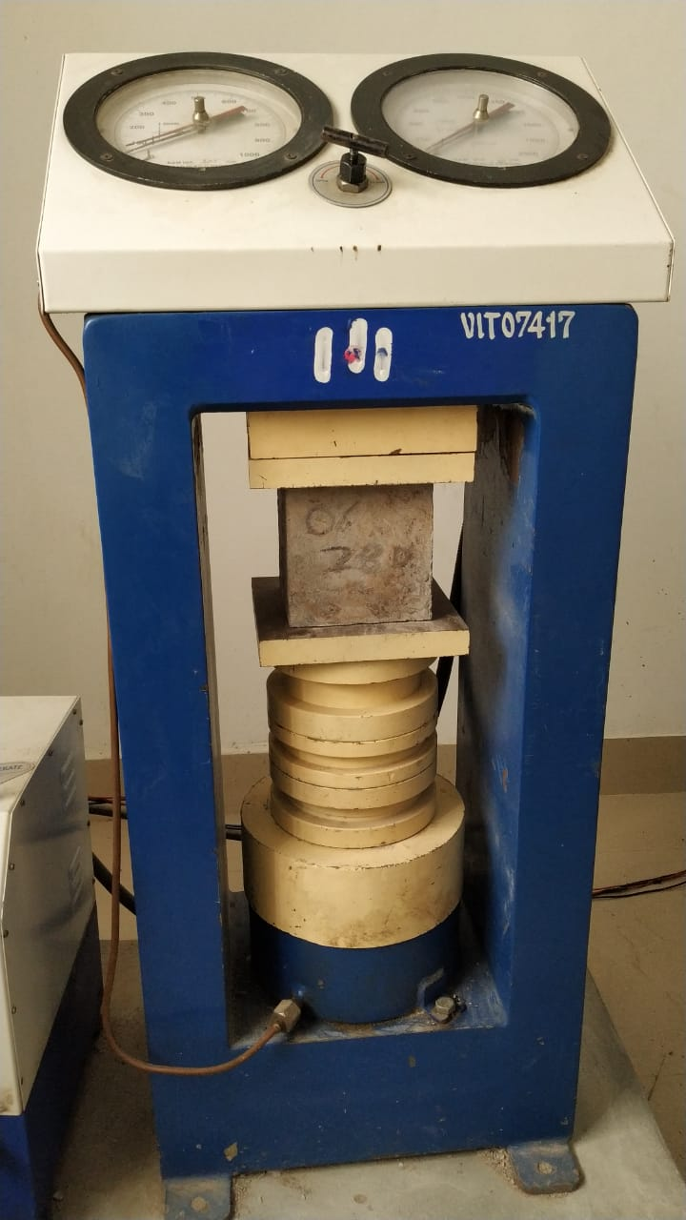
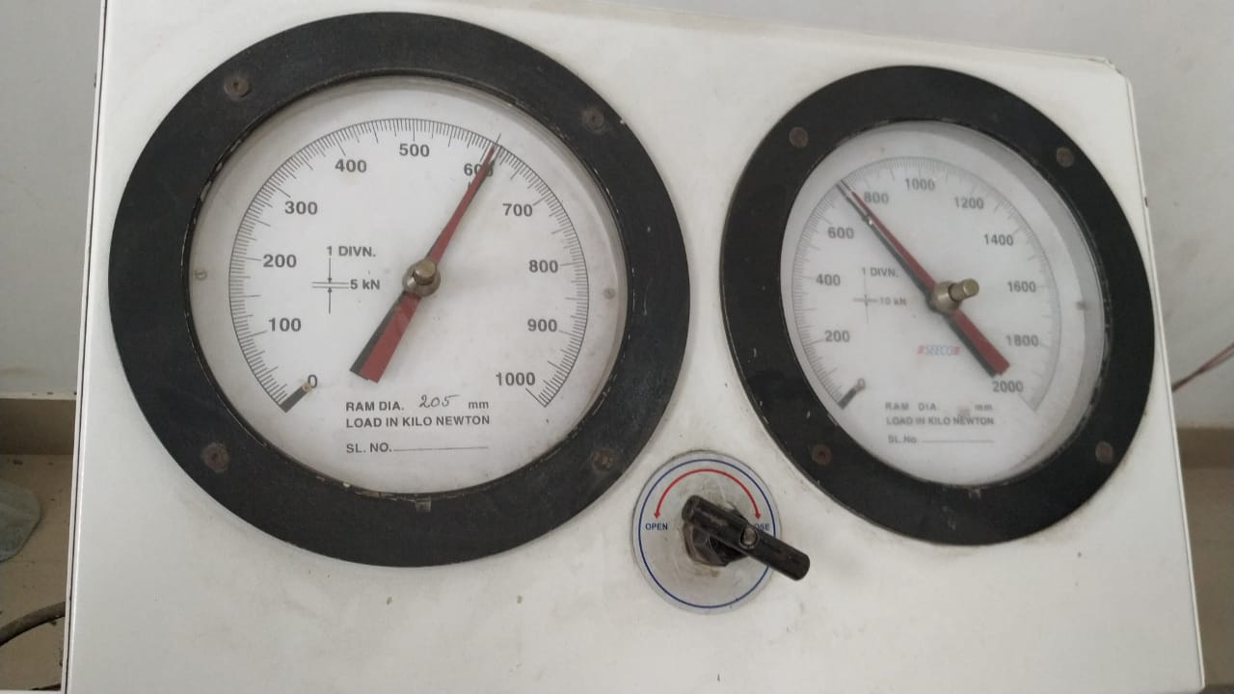
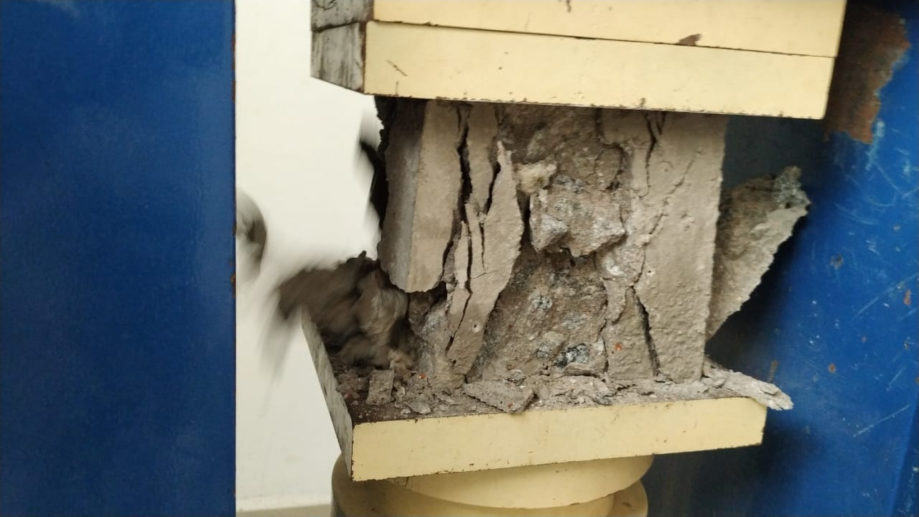
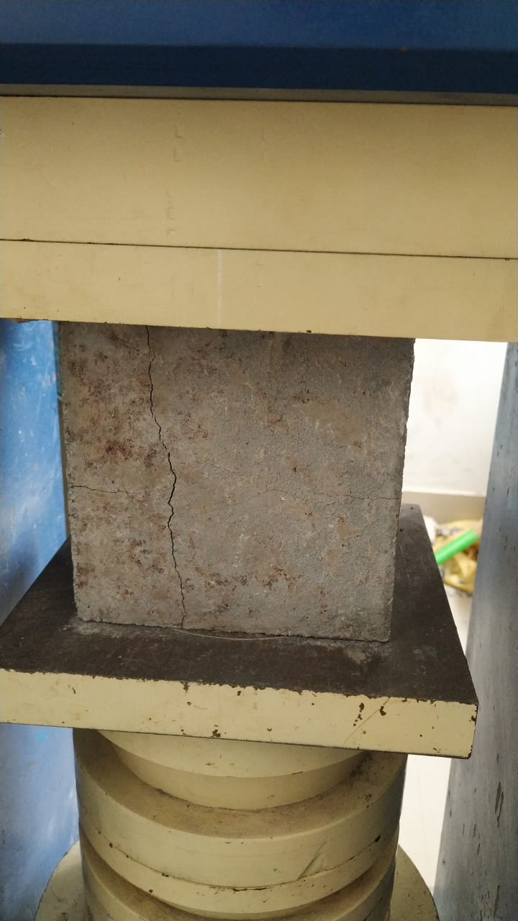
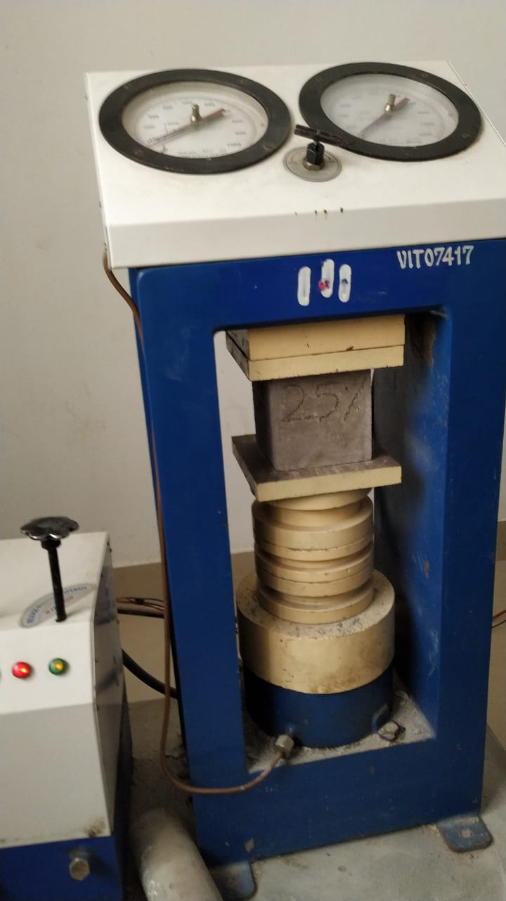
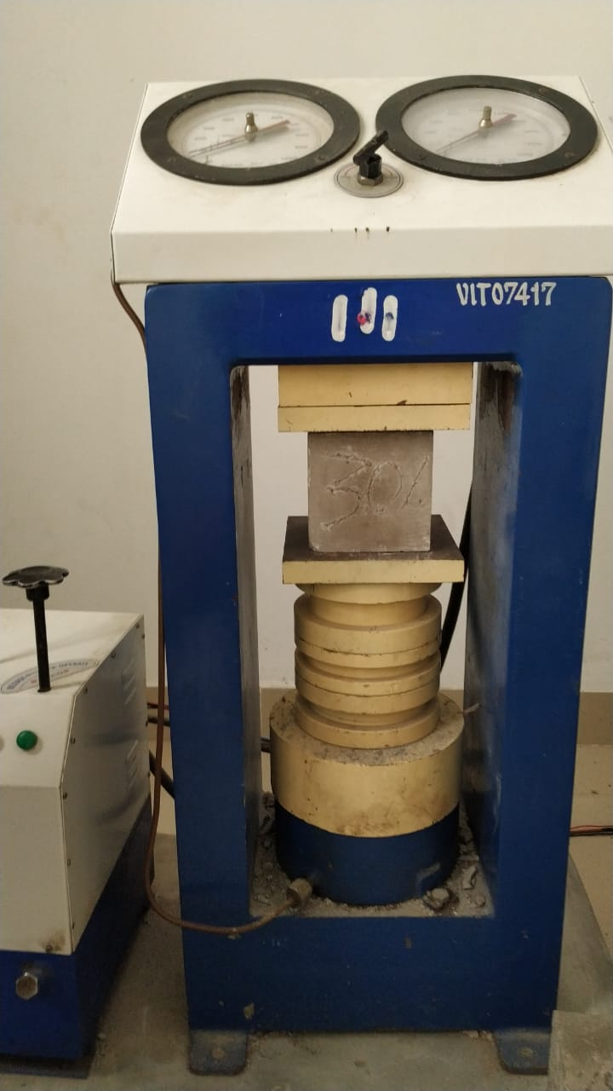
28 DAYS CURING
Cube without brick powder (0%)
Cube with brick powder (15%):
Cube with brick powder (25%)
Cube with brick powder (30%)

Slide 44
COMPRESSIVE STRENGTH RESULT; -
SI NO. | CUBE DESIGNATION | AREA IN mm² | LOAD IN KN | COMPRESSIVE STRENGTH (P/A) IN N/mm²
01 | 7 DAYS CURING
 | 0% | 22500 | 510 | 22.06
 | 15% | 22500 | 520 | 23.11
 | 25% | 22500 | 490 | 21.77
 | 30% | 22500 | 460 | 20.44
 | 40% | 22500 | 420 | 18.66
 | 50% | 22500 | 360 | 16
02 | 14 DAYS CURRING
 | 0% | 22500 | 580 | 25.77
 | 15% | 22500 | 630 | 28
 | 25% | 22500 | 610 | 27.1
 | 30% | 22500 | 580 | 25.7
 | 40% | 22500 | 540 | 24
 | 50% | 22500 | 460 | 20.4
03 | 28 DAYS CURRING
 | 0% | 22500 | 630 | 28
 | 15% | 22500 | 650 | 28.88
 | 25% | 22500 | 620 | 27.55
 | 30% | 22500 | 580 | 25.77
 | 40% | 22500 | 560 | 24.88
 | 50% | 22500 | 510 | 22.66

Slide 45
1. 7 DAYS CURING COMPRESSIVE STRENGTH

Slide 46
2. 14 DAYS CURING COMPRESSIVE STRENGTH

Slide 47
3. 28 DAYS CURING COMPRESSIVE STRENGTH

Slide 48
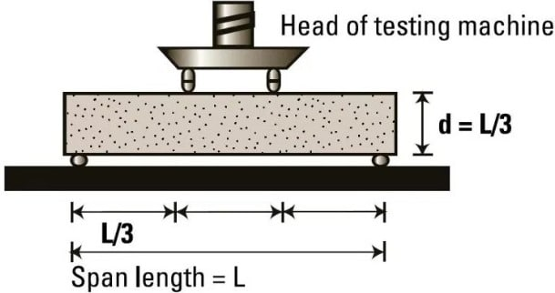
FLEXURAL TENSILE TEST
Flexural test evaluates the tensile strength of concrete indirectly. It tests the ability of unreinforced concrete beam or slab to withstand failure in bending. The results of flexural test on concrete expressed as a modulus of rupture which denotes as (MR) in MPa or psi

Slide 49
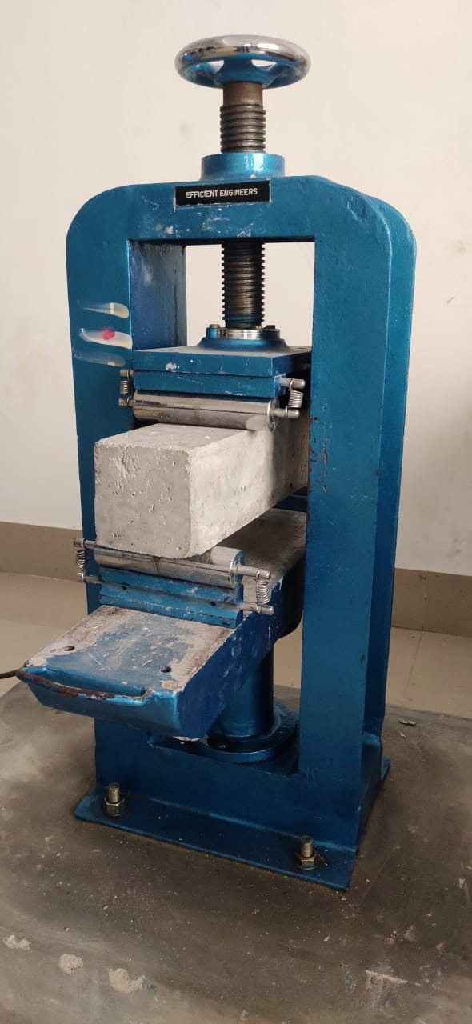
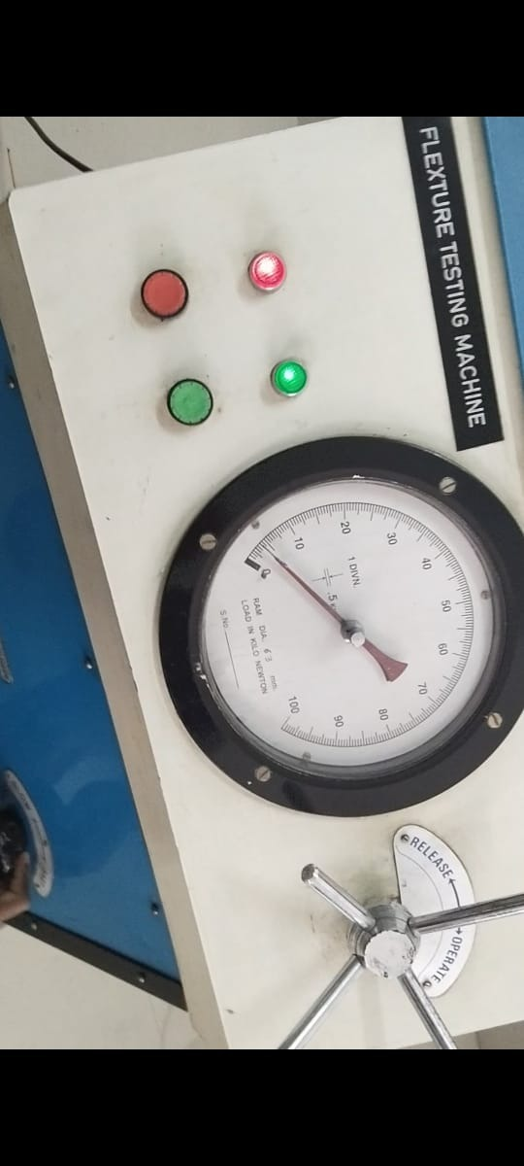
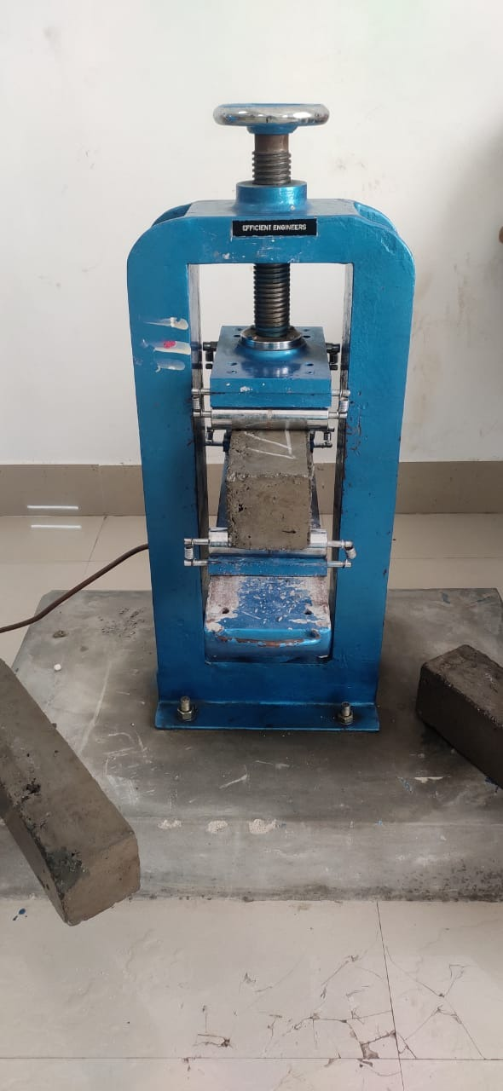
(0%) brick powder
(15%) with brick powder

Slide 50
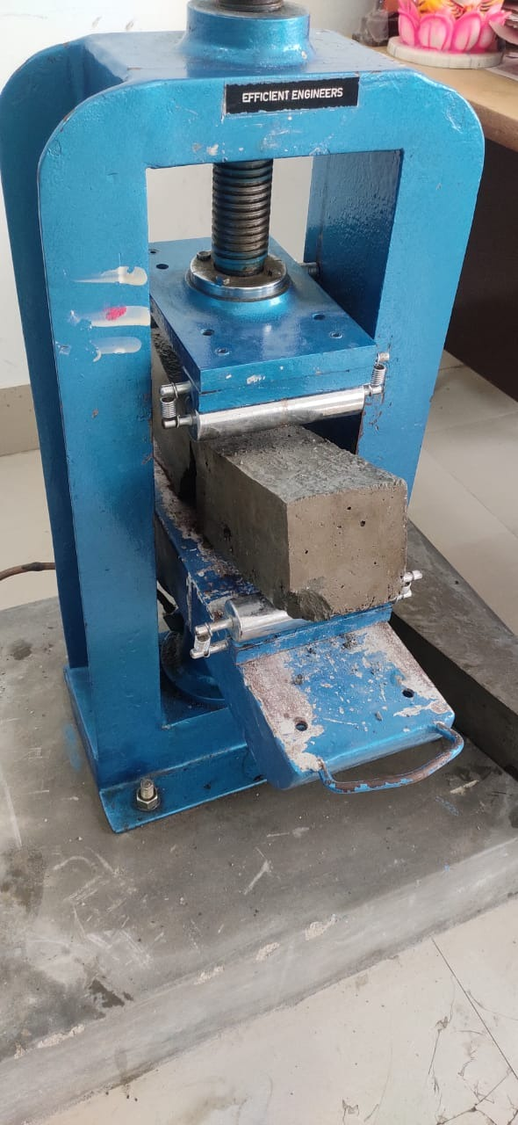

(40%) with brick powder
(50%) with brick powder

Slide 51
TABULAR COLUMN: 7 DAYS CURING
Sl. No. | Mark of beam/beam designation | Date of casting | Date of testing | Load (P) in KN | Flexural Strength N/mm²
1 | 7DAYS CURING
 | 0% | 7/06/2022 | 17/06/2022 | 11 | 2.42
 | 15% | 7/06/2022 | 17/06/2022 | 12 | 2.76
 | 25% | 7/06/2022 | 17/06/2022 | 10 | 2.3
 | 30% | 7/06/2022 | 17/06/2022 | 11 | 2.69
 | 40% | 7/06/2022 | 17/06/2022 | 10 | 2.11
 | 50% | 7/06/2022 | 17/06/2022 | 09 | 1.8

Slide 52
BAR CHART OF FLEXURAL STRENGTH 7 DAYS

Slide 53
TABULAR COLUMN: 28 DAYS CURING
2 | 28DAYS CURING | Date of casting | Date of testing | Load (P) in KN | Flexural Strength N/mm²
 | 0% | 09/06/2022 | 12/07/2022 | 15 | 3.6
 | 15% | 09/06/2022 | 12/07/2022 | 16 | 3.52
 | 25% | 09/06/2022 | 12/07/2022 | 14 | 3.36
 | 30% | 09/06/2022 | 12/07/2022 | 13 | 2.86
 | 40% | 09/06/2022 | 12/07/2022 | 11 | 2.42
 | 50% | 09/06/2022 | 12/07/2022 | 10 | 2.20

Slide 54
BAR CHART OF FLEXURAL STRENGTH 28 DAYS

Slide 55

SPLIT TENSILE TEST
Splitting tensile strength test on concrete cylinder is a technique to resolve the tensile strength of concrete. The concrete is very fragile in stress because of its fragile character and is not anticipated to oppose the direct tension. The concrete therefore gets splits and cracks when they are exposed to tensile forces.
Dept. of Civil Engineering, VKIT

Slide 56
TABULAR COLUMN: - 7 DAYS CURING
SI NO | REPLACEMENT | LOAD KN | SPLIT TENSILE STRENGHT N/mm²
01 | 7 DAYS
 | 0% | 110 | 1.56
 | 15% | 120 | 1.70
 | 25% | 100 | 1.41
 | 30% | 90 | 1.27
 | 40% | 80 | 1.2
 | 50% | 50 | 0.8

Slide 57
BAR CHART FOR SPLIT TEST: 7 DAYS

Slide 58
TABULAR COLUMN: - 28 DAYS CURING
02 | REPLACEMENT | LOAD KN | SPLIT TENSILE STRENGHT N/mm²
 | 0% | 200 | 2.83
 | 15% | 230 | 3.25
 | 25% | 210 | 2.97
 | 30% | 190 | 2.69
 | 40% | 160 | 2.26
 | 50% | 140 | 2.0

Slide 59
BAR CHART FOR SPLIT TEST 28 DAYS

Slide 60
CONCLUSION.
Based on the literature, brick debris or construction waste can be used as partial replacement of fine aggregate. We get a lot of waste material from the demolition site causing environmental pollution that construction waste can as partial replacement to fine aggregate or coarse aggregate.
This is an eco-friendly concrete as it subsides the stagnation of demolished brick waste by consuming it.
The test results of compressive strength show that the optimum replacement of fine aggregate is achieved at 15% replacement of fine aggregate by crushed brick debris compared to the respective conventional concrete strength
As much as of the total cost of fine aggregate in conventional method can be saved by this procedure
The possibility exists for the partial replacement of fine aggregate with brick debris which is produced during demolition of construction site.

Slide 61
REFERENCES
K. Muthusamy, A. M. A. Budiea, S. M. Syed Mohsin et al., Properties of fly ash cement brick containing palm oil clinker as fine aggregate replacement, Materials Today: Proceedings, https://doi.org/10.1016/j.matpr.2020.07.260
S. Rahul D, S. Vikas Reddy, T. N et al., Influence of brick waste and brick waste fines as fine aggregate on the properties of paver blocks – Preliminary investigation, Proceedings, https://doi.org/10.1016/j.matpr.2020.09.310
JuntaoDang, sze Daipang et al., Durability and micro structural properties of concrete with recycled brick as fine aggregate – Preliminary investigation, Proceedings, https://doi.org/10.1016/j.conbuildmat.2020.120032
Imane Rainia, Raouf Jabrane, et al., Evaluation of mortar properties by combining concrete and brick wastes as fine aggregate – Preliminary investigation, Proceedings, https://doi.org/10.1016/j.cscm.2020.e00434
Arivalagan. S Et al., Feasible and Experimental Study on Partial Replacement of Fine Aggregate using Construction Debris http://dx.doi.org/10.20902/IJCTR.2019.130206

Slide 62
Sai Samanth, and A. Prakhar, “Study of strength properties of concrete with construction debris as aggregates”, International Journal of Engineering Research in Mechanical and Civil Engineering, Vol. 1(5), pp 42-45, 2016
Diniya David, et al., Partial Replacement of Fine Aggregate with Crushed Clay Brick in Cellular Concrete. International Journal of Research in Engineering and Technology. DOI:10.15680/IJIRSET.2017.0605161
A. Shayan and A. Xu, “Value added utilization of waste glass in concrete”, Cement and Concrete Research, vol-44, pp.81-89, Jan.2004.
Shriharsha, Murthy S.N. Alternative building materials using fine ground granulated blast furnace slag and fine demolition debris. International Journal of Renewable Energy and Environmental Engineering. 2(2), 2014, pp 86-88.
IS 383-1970: Indian Standard specifications for coarse and fine aggregate. Bureau of Indian standards.
IS 456-2000: Code of Practice for Plain and Reinforced Concrete. Bureau of Indian standards.
IS 10262-2209: Recommended guidelines for Mix Concrete. Bureau of Indian standards.

Slide 63
THANK YOU

